Slide 1
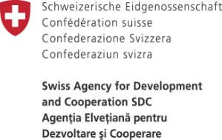
Key outcomes and actions from the equitable access self-assessment exercise Daniela Bordeianu, NGO SEAM

Slide 2
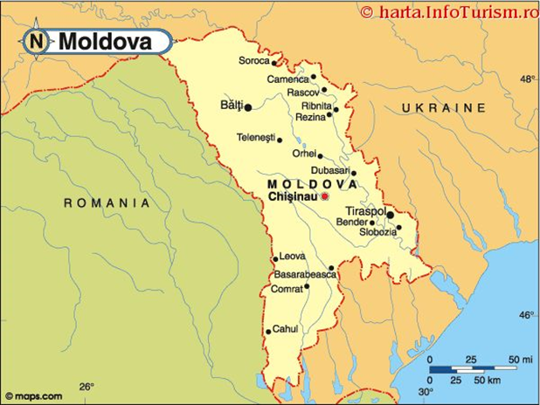
Where do I come from Republic of Moldova
-Bordered by Romania and Ukraine
-Population: 3.6 mill
-Extension: 33843,5 km2,
-Population below National poverty line: 17,5%
-Population living in rural areas: 52%
-Poor and deprived living in rural areas: 82% of total pop.
-After Independence (1991) the country is in continuous transition
-Transnistria conflict: major obstacle for improving human wellbeing of the population
The country follows the European course
Still the poorest country in Europe

Slide 3
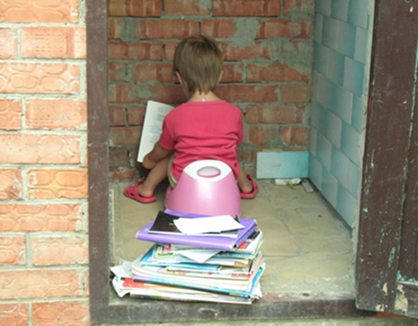
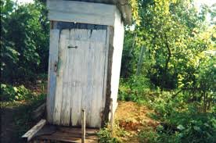
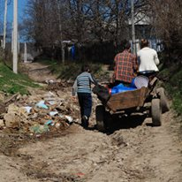
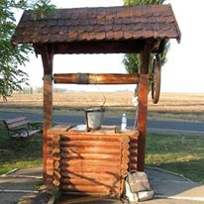
What do we believe in Solidarity Water Europe Moldova (SEAM)
SEAM - key issues that we deal with: water, sanitation, health through implementing educational programs, mobilization and empowerment of citizens (especially youth), and promoting the efficient management of water resources
SEAM advocates for improving access to water and sanitation for all citizens in terms of access and quality, with a particular equity lens
SEAM – coordinator of UNECE-SDC project in Moldova
Human rights to Water and Sanitation- a pivotal, mandatory right that has to be fullfilled for EACH citizen of the Global community!

Slide 4
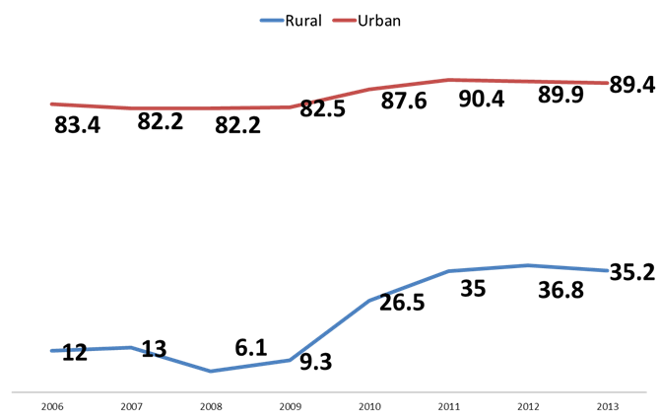
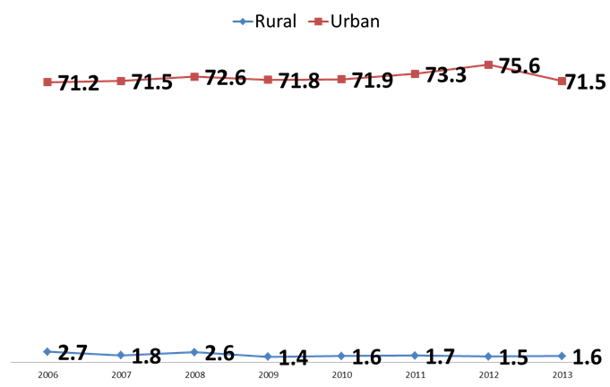
Why an equitable perspective?
Republic of Moldova committed through Millennium Developmental Goals to ensure access to safe drinking water to 59% of population in 2010 and to 65% in 2015 and to increase the share of population with access to improved sewerage to 50,3% in 2010 and 65% in 2015.
Despite the recent efforts in making water supply and sanitation available within rural regions in Moldova (the households with access to WSS have doubled in South and Centre regions in 2010 as compared to 2007) the graphs show that these goals were not achieved.

Slide 5
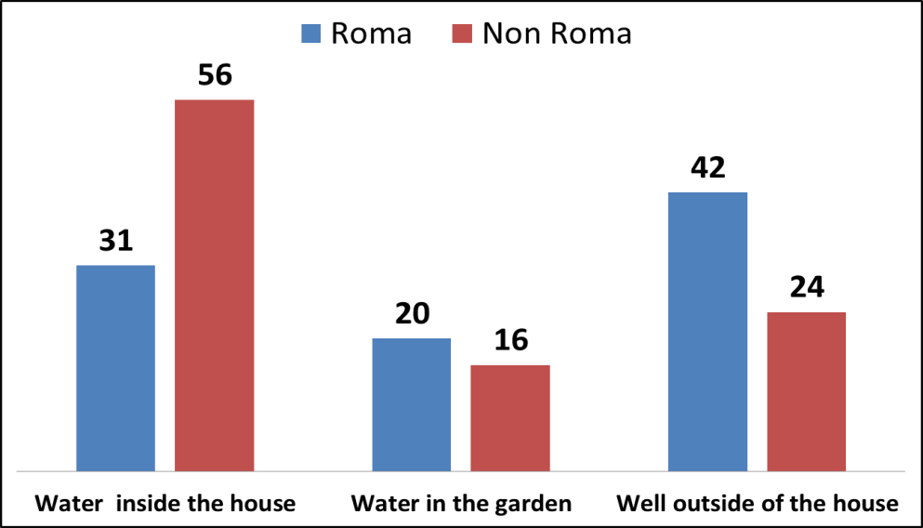
Why an equitable perspective?
Access gap for water and sanitation between richest and poorest quintile: (1) was very significant in 2006 – 37, 7%, (2) the gap was not reduced at all but increased significantly.
Applying equitable access score-card
Initial objective: Support decision makers in ensuring full achievement of the Human rights to water and sanitation for every citizen, whether rich or poor, living in rural or urban areas, disabled or belonging to a minority, men or women, have W/S services that are accessible, safe, acceptable and affordable for all without any discrimination.
Notes:
The equitable access perspective should be at the center of water and sanitation policies, that means understanding and taking in to account specific circumstances that create and lead to inequalities in terms of water and sanitation. Unfortunately, for the last decade public policies for water and sanitation have failed the poorest members of Moldovan society. Moldovan authorities should learn from past mistakes and use the opportunity of this new policy cycle to have a stronger consideration for the specific factors that lead to significant inequalities in access, find the best ways to empower the most vulnerable and marginalized as to ensure their rightful access to adequate water and sanitation.

Slide 6
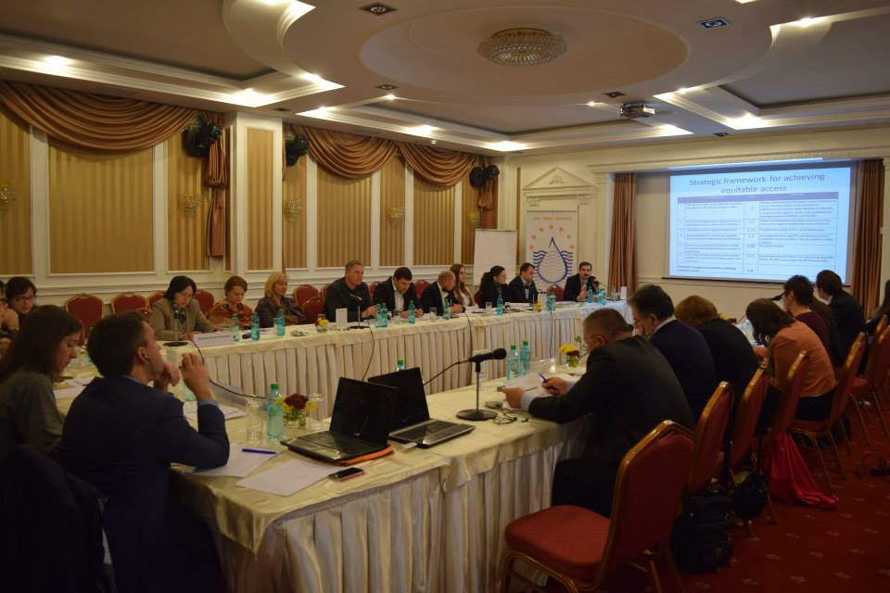
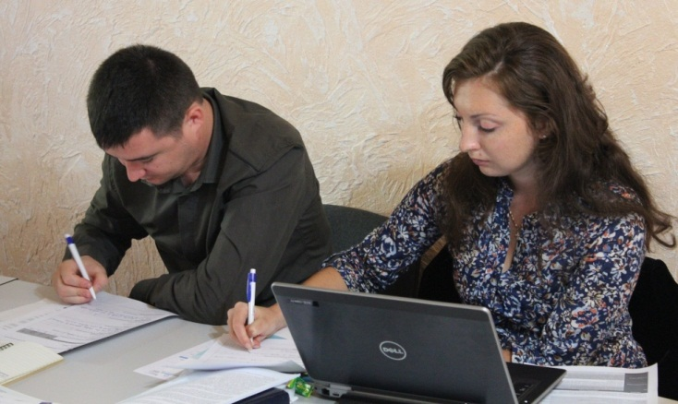
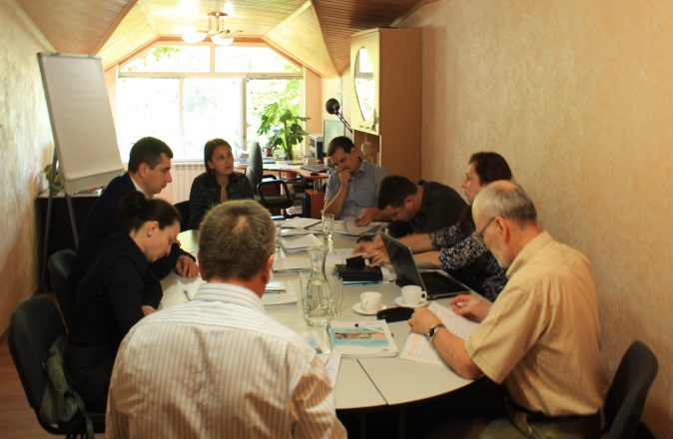
Process of applying the Score-card
Period of Implementation: 1 April- 31 December 2015
Participants: Representatives of ministries of environment, health, regional development and construction, water agency Apele Moldovei, National Centre for Public Health, Association Moldova Apa-Canal, National Agency for Energy and Regulation, Congress of Local Authorities, NGOs SEAM, Eco-Tiras, National Environmental Center; Swiss Cooperation Office (ApaSan), Austrian Development Cooperation, UNDP/ART initiative, OECD. International Experts: Chantal Demilecamps, Roberto Martin-Hurtado (UNECE) Hanna Tsvietkova (Ukraine)
Difficulties faced: New issue for Moldova/Complex and comprehensive methodology/Time and financial pressure/Difficulty to overcome the already set mentality/Lack of time and resources of the entities addressed etc.
Equitable access score-card results based on each equitability area:
Steering governance framework to deliver equitable access to safe W/S: 1,36
Reducing Geographical disparities: 1,11
Ensuring access for vulnerable and marginalized groups: 1,12
Keeping Water and Sanitation affordable for all: 0,28
AVERAGE SCORE- 1
Notes:
First Phase( May-August): Contraction of the National Expert/Data collection/First meeting development
Second Phase(September -November)): Extension of the stakeholders platform involved, data collection, preliminary data consolidation/Second meeting of the expert group
Final phase(November-December): Final workshop development/Results presentation of the exercise piloted in Moldova, Control meeting conduct
Follow-up: Document review, translation, editing; distribution and information dissemination

Slide 7
Main Findings
Current policy frameworks for W/S take equitable perspective into account only to a little extent
Most relevant access gaps are recognized, especially gaps related to poor/rich and rural/urban households, but the public policy approach is not human rights based
Relevant vulnerable groups are almost not taken into account in policy approach
The affordability section of the score-card is the one with the lowest score. The issue of how affordability of water and sanitation will be ensured is left to the local public administrations, water utilities and water users associations.
Without awareness and incentives, these local stakeholders will fail to give the affordability the priority it deserves
Moldova needs a more effective water and sanitation strategy built on the equitable access approach
Notes:
Current Strategy is handicapped by: (1) having a generic vision on how specific access gaps for most vulnerable groups will be closed or at least reduced, (2) having no specific time bound targets, (3) failing to clarify specific equitable access mandates for the involved institutions

Slide 8
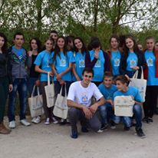
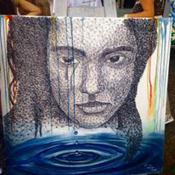
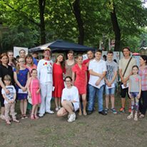
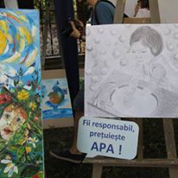
Impressions and action
The score-card tool: schematic and very structured tool, but with very human touch
The implementation process: foresees communication, collaboration, common efforts and promotion of the results
Follow up results
Action plan on addressing score card results discussed by Ministry of Environment
Inclusion of the equity targets in the National Programme to implement Protocol
Initiation of sustainability research regarding Solidarity Funds in Moldova
Ownership and knowledge gained by the Ministry of Environment on human rights to W/S and equitable perspective
Numerous communication and promotional activities developed for general public
Notes:
But still, a lot has to be done

Slide 9
Safe Water and Sanitation for all Thank You
Daniela BORDEIANU
Head of SEAM NGO
d.bordeianu@seam.md
www.seam.md

